Slide 1
PLEASE LIKE US ON
National Rural Development Programme 2014 – 2020
Implemented by Waterford Leader Partnership
on behalf of WLCDC and WC&CC as financial partner

Slide 2
AGENDA
Background
New application process
What you need to apply
Scoring
Points to note
Questions & Answers
Contact details

Slide 3
Section 1: Background

Slide 4
Established in 1991 to address rural decline in West Waterford, Waterford Leader Partnership CLG (WLP) has over 20 years experience in delivering Rural Development Programmes in County Waterford;
LEADER Pilot
LEADER 2
LEADER +
RDP 2007-2013
The new RDP 2014-2020
The Company currently operates the Local Employment Service (LES)/Intreo, TÚS and Rural Social Scheme (RSS) for the (Department of Social Protections)DSP
WLP will operate as the implementer for the Waterford Local Community Development Committee (LCDC) in delivering the new RDP 2014-2020 programme

Slide 5
Waterford Local Community Development Company (LCDC) was established in 2014 under the provision of Part 6 of the Local Government Reform Act. It is an independent committee of Waterford City & County Council (WC&CC)
It comprises of public and private sector members including Waterford City & County Council members and officials, State agencies and private sector local and community development representatives
Waterford City & County Council will be the lead financial partner while Waterford Leader Partnership (WLP) will be the implementer of the RD/LEADER programme on behalf of the Waterford LCDC. The LCDC will be the final decision maker as to project approvals

Slide 6
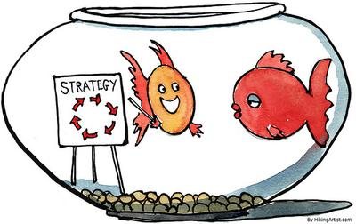
LEADER involves the design and delivery of Local Development Strategies. Each LDS is a community led plan, developed and driven by rural communities to address local identified needs through optimum measurable objectives.
All funding decisions are underpinned by the LDS objectives and priorities
This process started in Jan 2015 with a lengthy consultation process to analyse the needs of the area
A SWOT analysis was undertaken to reflect the outcomes of the consultation process, performance review of the previous LEADER programme and the demographic and socio economic baseline data for the county
It is the approval of the LDS at national level which resulted in the award of the new Rural Development for the County

Slide 7
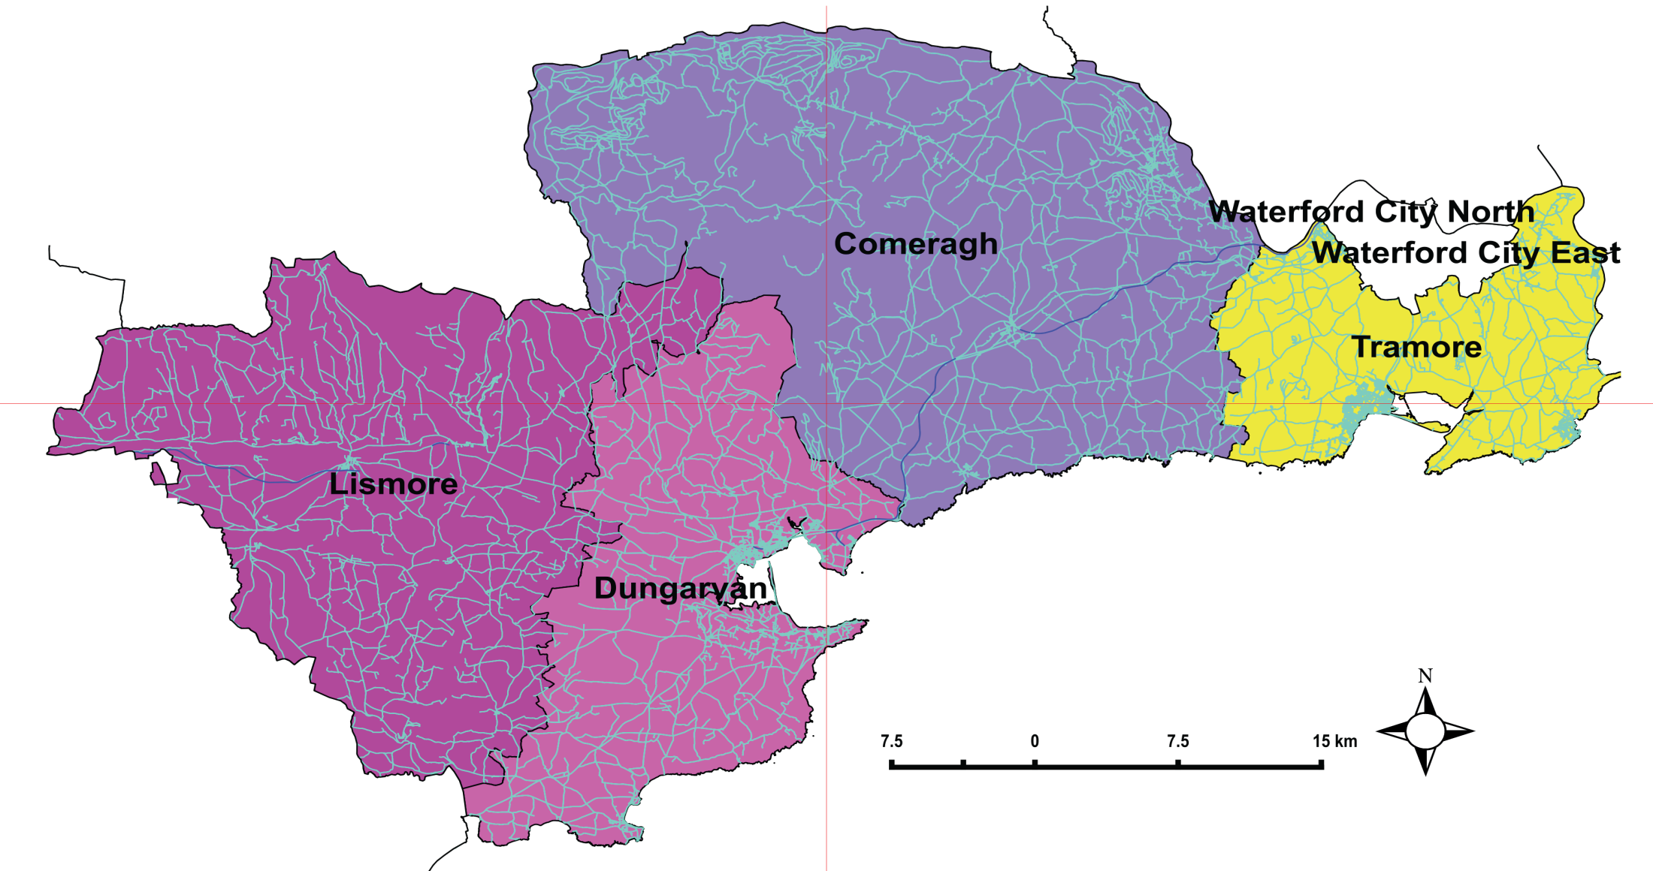
Source: CSO Composite EA 2008
The programme covers all of rural Co. Waterford, but excludes the area covered by the original Waterford City boundary
Implementation Area by Electoral Area
The CSO Census 2011 records the population of area as 67,063 persons. This includes the population of the Gaeltacht area. The two main towns in the area are Tramore and Dungarvan. The 2011 Census records these as having a population of 9,508 and 7,996 respectively.

Slide 8
National Rural Development/
LEADER Programme 2014-2020
Section 2: New application process!

Slide 9
The New versus the Old RD Programme 2007-2014
New structure - WLP implementing the programme & WC&CC acting as financial partner on behalf of the LCDC who are the final decision makers!
Supporting businesses employing 9 – 50 staff (previously 0-9 micro enterprises)
29% reduction in the budget
2 Stage application process.......

Slide 10
Programme Funding of €7,522,796.00 Project Funding of €5,642,097
PLEASE LIKE US ON
RDP Theme:
Economic Development, Enterprise Development and Job Creation
Sub Themes:
Rural Tourism
Broadband
RDP Theme:
Social Inclusion
Sub Themes:
Basic Services Targeted at Hard to Reach Communities
Rural Youth
RDP Theme:
Rural Environment
Sub Themes:
Protection and Sustainable use of Water Resources
Development of Renewable Energy
Enterprise Development
Rural Towns
Protection and Improvement of Local Biodiversity

Slide 11
Eligible costs
Construction or improvement of immovable property
Purchase of new machinery and equipment up to the market value of the asset & 2nd hand machinery in certain cases
General costs linked to construction/adaptation of a building such as architect, engineer and consultant fees up to a ceiling of 12% of the capital costs of such projects. (Professional fees are not permitted as a stand alone project). Planning application fees are not eligible

Slide 12
Ineligible sectors and activities
Agriculture & Fisheries
Conventional retail operations
Loans, working capital (including stock) and insurance
Horticulture (including bee-keeping)
Payments for gifts, donations or personal entertainment
Statutory fines and penalties, criminal fines and damages, legal expenses in respect of litigation
Costs associated with meeting a legislative or statutory requirement
Reclaimable VAT
Improvements/refurbishment of private residential property
Projects that already have other EU funding either directly or through a national programme
Conventional motor vehicles, including cars, industrial/farm/construction vehicles, vans and buses
General maintenance works of public bodies
Childcare, Health Care, Nursing Homes & Housing
Race horse and sport horse businesses not open to the public
Greyhound industry

Slide 13
The Process!
When a targeted call for proposals is announced and the call opens.,
The targeted call is a two stage process
Stage 1 - Call for Expressions of interest (EOI's)
Stage 2 - Application stage
Those successful at EOI stage will be invited to submit an application as part of the second stage of the targeted call. Every successful EOI will be informed of the qualifying criteria and marking scheme to be used, together with the timeframe for assessing and notifying applicants of the results of the process.

Slide 14
6 Targeted Calls for funding linked to the Local Development Strategy (LDS)
Total Budget for 2nd Targeted call €2,145,537
RDP Theme: 1
Economic Development, Enterprise Development and Job Creation
Sub Themes:
LO 1: Rural Tourism
SA1.1 €245,607
SA1.2 €305,735
SA1.4 €193,089
RDP Theme:2
Social Inclusion
Sub Themes:
L05: Basic Services Targeted at Hard to Reach Communities
SA5.1 €380,000
RDP Theme:3
Rural Environment
Sub Themes:
LO9: Development of Renewable Energy
SA8.1 €7,765
LO2: Enterprise Development
SA2.1 €384,840
SA2.2 €205,000
SA2.3 €262,059
LO7: Protection and Improvement of Local Biodiversity
SA7.1 €7,765
LO6: Rural Youth
SA6.2 €32,354

Slide 15
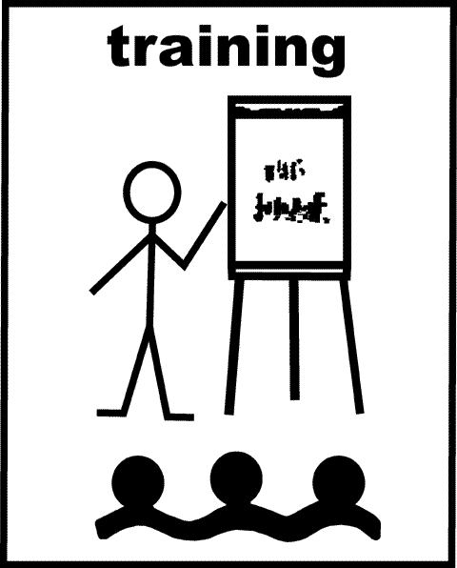
Six Targeted Calls for Proposals
Stage I
Open Mon 22nd May
Close Fri 2nd June
Stage II
Open Fri 16th June
Close Fri 11th Aug
Enterprise
Stage I
Open Mon 22nd May
Close Fri 2nd June
Community
Stage I
Open Mon 22nd May
Close Fri 2nd June
Stage II
Open Fri 16th June
Close Fri 11th Aug
Stage II
Open Fri 16th June
Close Fri 11th Aug
Rural Tourism
Renewable Energy
Biodiversity
Rural Youth
Theme 1
Theme 2
Theme 3
Stage I
Open Mon 22nd May
Close Fri 2nd June
Stage I
Open Mon 22nd May
Close Fri 2nd June
Stage I
Open Mon 21st Nov
Close Fri 2nd Dec
Stage I
Open Mon 22nd May
Close Fri 2nd June
Evaluation
Evaluation
Evaluation
Evaluation
Evaluation
Evaluation
OR
OR
OR
OR
OR
OR
Stage II
Open Fri 16th June Close Fri 11th Aug
Stage II
Open Fri 16th June
Close Fri 11th Aug
Stage II
Open Fri 16th June
Close Fri 11th Aug
Evaluation
(Sept – Oct)
Evaluation
(Sept – Oct)
Evaluation
(Sept – Oct)
Evaluation
(Sept – Oct)
Evaluation
(Sept – Oct)
Evaluation
(Sept – Oct)
OR
OR
OR
OR
OR
OR

Slide 16
Rate of aid
The maximum support available is €200,000. Minimum grant is €5,000
Funding may be awarded under all themes and sub themes to a maximum of 50%of the total project cost. The rate of aid offered will be considered on a project by project basis.
Higher maximum rate of aid may be applied for community based projects where there is no commercial basis for the project as follows;
- Community body or applicant - 75% (Up to 90% might be considered under the Basic services targeted at hard to reach communities sub theme)
- Private individual/company/community social enterprise – 50%

Slide 17
Section 3: What you need to do to apply?

Slide 18
Who’s eligible to apply:-
Community Groups / Non-Profit Companies
Farming Families
Individuals, sole traders or companies

Slide 19
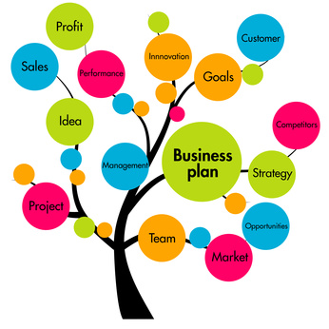
Business plan/Community Plan
Detailed business plan/community plan
Audited accounts for the last 3 years (for an existing business) or income & expenditure (community) and bank statements (minimum of 3 months)
Projected 5 year cash flow projections
Certification of incorporation, memorandum & article of association for limited companies or Constitution if non formalised community group

Slide 20
Match funding
A promoter must have the required match funding in place and has adequate resources or bridging finance in place to deliver the project
Evidenced by means of a bank statement or signed loan agreement with the bank or equivalent such as Clann Credo (Social Investment fund)

Slide 21
Construction/adaptation work
Where project involves construction work, evidence of the applicant’s right to carry out the work on the site or existing building e.g. Title or deeds if owned/lease for minimum of 5 years
Planning permission, exemptions from planning from the Local Authority

Slide 22
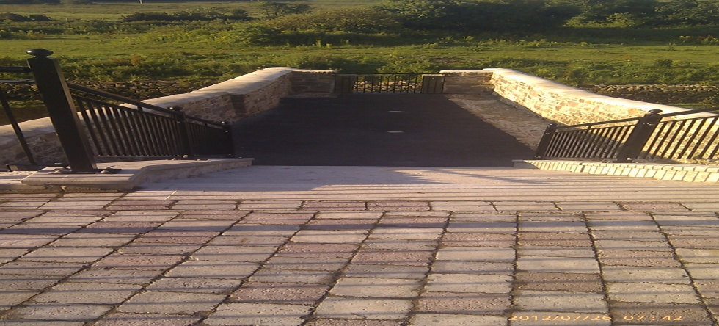
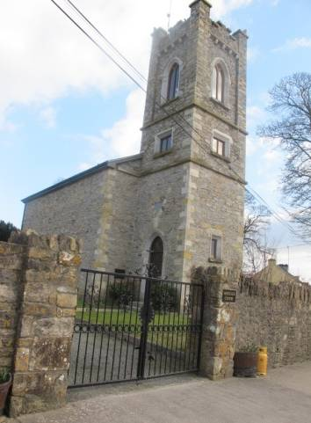
Conservation projects
Specific Heritage Project Requirements apply in the case of projects affecting heritage. These projects are defined as those that will impact, or have potential to impact upon structures, places or sites of heritage interest
Heritage projects must be requested to contact the Conservation Officer with the Local Authority and submitted to the Heritage Projects Review Panel (established at national level)

Slide 23
Procurement – Tenders/Quotes
The purpose is to ensure your project represents value for money & that your goods are procured in a fair, open & transparent manner;
Mandatory requirement;
A detailed written specification of what you need which must not include brand names
Evidence that suppliers were asked to tender/quote
Evidence of quotations/tenders submitted by supplier
Selection of supplier based on price or reasonableness of costs

Slide 24
Tendering requirement: Supplies/Services/Works Contract & Non Contracting Authorities
Amount (ex VAT) | Procedure
€0-€5,000 | Obtain a minimum of 3 written quotes from competitive suppliers on headed paper
€5,001-€25,000 (Services & Supplies) | Obtain a minimum of 3 written quotations from competitive suppliers on headed paper
Greater than €25,000 (Services and Supplies) Contracting bodies in receipt of more than 50% funding i.e. Community applicants | Obtain a minimum of 5 written quotations and place a notice in a local or national newspaper Advertise all contracts for supplies & services on www.etenders.gov.ie for a minimum of 21 days Promoters are required to publish all contract notices on the e-tenders website on completion of the award
€5,000-€50,000 (Works) | Obtain at least 5 written quotations or advertise on e tenders website for minimum of 21 days
Greater than €50,000 (Works) Contracting bodies in receipt of more than 50% funding i.e. Community applicants | Obtain at least 5 written quotations or advertise on e tenders website for minimum of 21 days Advertise all contracts on www.etenders.gov.ie for a minimum of 21 days. Promoters are required to publish all contract notices on the e-tenders website on completion of the award

Slide 25
Etenders report
Request for tender
Evidence of publication
Responses to those tender requests
Tender scoring sheets used & evidence to back up the reason for selecting the successful tender
Notification of intention to award
Copies of letters notifying unsuccessful tenders of the result of the tender process

Slide 26
Section 4: Scoring

Slide 27
Stage I: Assessing the eligibility of Expression of Interest forms (EOI’s)
As per the relevant EU regulations
The Rural Development Programme 2014-2020, programme objectives, specific theme & sub theme for which funding is being sought
The operating rules
The objectives and actions identified in the Local Development Strategy (LDS)

Slide 28
Project Selection Process
Stage 1
Stage 2
Stage 1
EOI Call 2 weeks & 2 weeks assessment
Stage II
Call open for 8 weeks
4 weeks
2 weeks
2 weeks
SAMPLE TIMELINE – 20 weeks
2 weeks

Slide 29
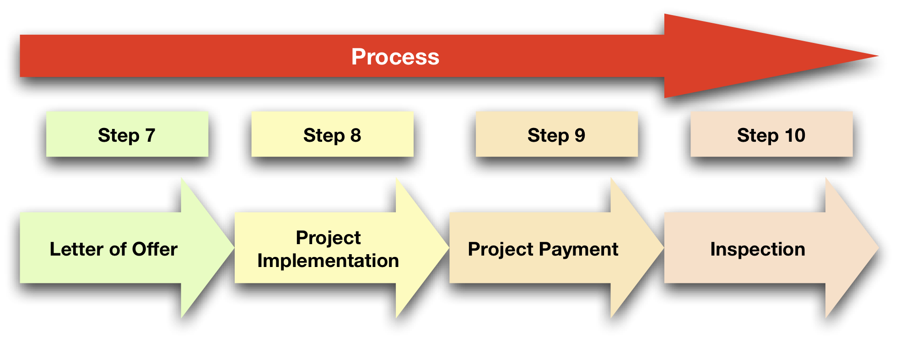
2 weeks
6 months
Up to 5 phased payments within 6 month period
Up to 5 yrs after pmt

Slide 30
Stage II: Scoring of complete funding applications
An Evaluation Committee will score applications under the following criteria;
Evaluation Criteria Weighting
Compatibility with Local Development Strategy 20
Innovation 15
Promoter experience 20
Financial viability 20
Sustainability 10
Requirement for the project 15
Total 100

Slide 31
Projects must receive a minimum score of 60% before being recommended to the LCDC for a decision. All EOI and project applicants will be notified in writing, setting out clearly the rationale for its decision
If successful, a valid commitment of LEADER funding to a project applicant only exists when -
- the LCDC has made its decision; and
- a letter of offer or contract, clearly stating the funded activity or items, has issued to the applicant; and
- the offer or contract has been accepted in writing and returned by the applicant within the period prescribed by the LAG in the letter of offer

Slide 32
Section 5:Points to note

Slide 33
Ensure all necessary consents and permissions are obtained
Evidence of all necessary insurance
Tax clearance certificates from all suppliers of goods and services including non EU providers

Slide 34
Projects will not be grant aided which are capable of proceeding without LEADER funding (‘deadweight’)
Displacement occurs where an activity funded impacts negatively on activity elsewhere
LEADER will not fund projects that are eligible under other EU funded schemes or can be funded by other agencies
LEO’s have primary responsibility for micro enterprise support (0-9 employees) & will assist promoters with skills necessary to implement their projects

Slide 35
This programme does not offer advance payments. The grant is paid in arrears, you pay for the project and submit a claim to us for reimbursement
Should costs prove higher than expected, No increase in grant aid will be made!
We will not pay for any expenditure not listed in your letter of offer. So PLAN CAREFULLY! BE SPECIFIC!

Slide 36
A project will be monitored/audited up to
5 years after last payment received. If the project ceases trading/closes within that period, a full repayment of the grant will be required
The success of your application will be monitored so
BE REALISTIC. Your performance indicators will be
checked on an annual basis for 5 years from grant payment
If a project commences prior to approval, no retrospective funding will be provided and may deem your entire project ineligible

Slide 37
Your letter of offer will have a 6 month expiry date. Please ensure that you give enough prior notice should you require approval of an extension (granted in exceptional circumstances)!
A false declaration of any project info/documentation will mean full repayment of the grant and exclusion from receiving support in the following calendar year

Slide 38
De minimis
No more than €200,000 offered in state aid during the previous three year fiscal period. (de minimis threshold established for State aid)
Public funding is deemed to be ‘state aid’ where it provides the recipient, whether an enterprise, not for profit organisation, or an individual, an advantage over others.
Declare the amount of aid received, purpose for which aid was provided & date it was awarded

Slide 39
Phased payments
A prior request made by the promoter at time of application
At least 20% of total eligible costs have been incurred by the promoter at each staged payment
The maximum number of phased payments on a project is 5

Slide 40
From the 1st Targeted Call!

Slide 41
86 EOI’s received in the 1st targeted call for funding (22nd Nov ’16 – 2nd Dec ’16)
28 Applications were submitted (23rd Jan – 16th March ‘17)
12 were deemed eligible with the required standard of documentation
Contracts will be issued to those approved in mid June ‘17

Slide 42
Planning timelines not met! – DO NOT WAIT! Enquire if you need planning now & apply immediately! Same applies to heritage consents etc
Procurement – not the required number of quotations submitted for the funding sought
No Tender Reports – showing how the costs were procured and scored
Not all documentation submitted as per checklist provided or incomplete application form

Slide 43
To help you achieve!
Information Workshops will be held in Tramore & Dungarvan prior to call for applications to go through the overall process
Everyone will have the support of three one to one meetings with a project officer prior to submitting an application during the 2nd stage of the call
Please make use of these meetings to ensure a good quality submission
We have business/community plan templates to help you!
Submit early to ensure your application can be reviewed and feedback provided before the close off date!

Slide 44
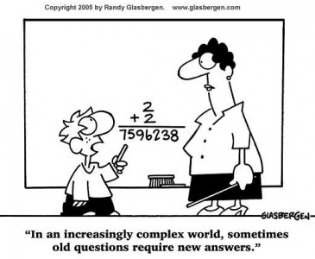
Section 6: Q & A Session

Slide 45
Contact details;
Claire Connors, Presentation Community Centre, Mitchell St, Dungarvan.
Tel: 058 51505/087 2311062. Email:claire.connors@wlp.ie
Jimmy Taaffe, Lismore Business Park, Lismore.
Tel: 058 54646/087 2588712.
Email: jimmy.taaffe@wlp.ie
www.wlp.ie Follow us on Facebook!

